Slide 1
Discrete Mathematics (21MA206T)
Course Co-ordinator
Dr. Pritam Kocherlakota
1

Slide 2
My Introduction
Dr. Pritam Kocherlakota
Assistant Professor
Department of Mathematics
School of Technology
Pandit Deendayal Energy University
8500258776
Kocherlakota.Pritam@sot.pdpu.ac.in
kspritam@gmail.com

Slide 3
Course Structure
3

Slide 4
UNIT 1 SETS, RELATIONS, FUNCTIONS AND LOGIC
Finite and Infinite sets,
Countable and Uncountable sets,
Mathematical Induction,
Functions and Relations,
Types of Relation,
Partial Ordered Relations,
Hasse diagram and Lattice.
Propositions - Simple and Compound.
Basic logical operators. Implication. Truth tables. Tautologies, Contradictions and Contingency.
Valid arguments and Fallacy.
4

Slide 5
UNIT 2 COMBINATORICS
Recursive functions,
Recurrence relations,
Solutions of recurrence relations (Direct Method and by using Generating Function),
Counting principles,
Permutation, Combination,
Derangement,
Inclusion-exclusion principle,
Pigeon hole principle,
Extended Pigeon hole principle.
5

Slide 6
UNIT 3 GRAPH THEORY AND ITS APPLICATIONS
Binary Operation, Graphs and related definitions, Sub graphs
Homomorphism and Isomorphism,
Paths and Connectivity. Bipartite graph.
Eulerian graph and Konigsberg Bridge problem.
Hamiltonian graph. Labeled and weighted graphs.
Graph coloring. Four color problem. Planar Graphs.
Digraphs and related definitions. Trees.
Algebraic expressions and Polish notation.
Sequential representation. Adjacency matrix.
Shortest path Algorithms (Dijkstra), Binary trees,
Strongly and weakly connected graphs,
Powers of the adjacency matrix,
Floyd-Warshall algorithm,
Application of Graph theory in real-life applications.
6

Slide 7
UNIT 4 ALGEBRAIC STRUCTURES
Group,
Semi group,
Monoids, Properties of a Group,
Composition table for finite Group,
Order of a group,
Order of its elements,
Cyclic Group, Generator,
Lagrange’s Theorem.
Ring, Properties of Rings,
Integral Domain,
Field.

Slide 8
TEXT / REFERENCE BOOKS
Seymour Lipschutz and Marc Lipson, Discrete
ed., McGraw-Hill
Mathematics, Schaum’s Series,
₃rd
Education, 2009.
Kenneth Rosen, Discrete Mathematics and Its Applications, 7th ed., McGraw Hill Education, 2017.
Bernard Kolman, Robert Busby and Sharon C. Ross, Discrete Mathematical Structures, 6th ed., Pearson, 1998.
Thomas Koshy, Discrete Mathematics with Applications,
Academic Press Inc., 2004.
Ralph P. Gramaldi, Discrete and Combinatorial Mathematics, 5th ed., Pearson, 2006.
C.L. Liu, D.P. Mohapatra, Elements of Discrete Mathematics:
₄th
A Computer Oriented Approach, ed., McGraw Hill
Education, 2017.

Slide 9
COURSE OUTCOMES
On completion of the course, you should be able to
CO1 – Identify structures of algebraic nature, prove and use their properties.
CO2 – Understand the basic concepts of sets, relations, functions, logic and be able to determine their properties.
CO3 – Apply the basic techniques of Combinatorics and Counting.
CO4 – Apply Graph theory in related areas such as minimal-path problems and network flow problems.
CO5 – Defend and point out fallacious reasoning and propositions.
CO6 – Construct and solve recurrence relations that arise in counting problems including problems of determining the time complexity of recursively defined algorithms.

Slide 10
Delivery of Lectures
First 5 minutes: Revision of Last lecture
The students will be informed in advance about their turn & topic of presentation.

Slide 11
Last 5 minutes
This time will be spent in summarizing the lecture and students can ask questions.
Information regarding the topic of the next lecture should be shared for the next lecture.

Slide 12
Discrete Mathematical Structures
 | Type of Evaluations
1 | Internal Assessments | 25 Marks
2 | Mid Semester | 25 Marks
3 | End Semester | 50 Marks

Slide 13
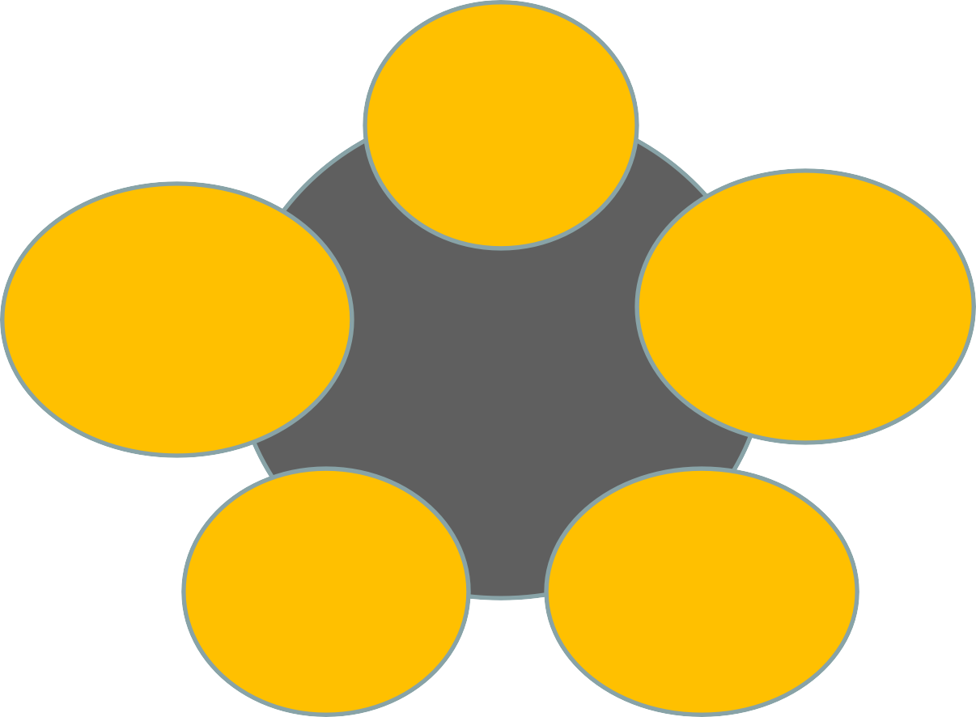
Pedagogy to be undertaken for course delivery
Content
(PPT,
Hand written notes)
Evaluation,
Self-paced, Independent Study
Learning
Pedagogy
Assessment (Assignment,
Quizzes)
Software to be used (Microsoft Team)
Interactive Classes

Slide 14
What to do?
Make the session interactive.
Complete all the assignment on time.
Attend the class regularly.
Give attendance properly.
Inform me through email before approaching me in office hours. Send the discussion topic in email.
The email should be at least one day before.
Encourage your classmates to study.
Check your attendance daily.

Slide 15
What not to do
Do not talk in the class during lecture hours.
Do not come late in class room.
Do not make noise in the class room.
Do not disturbs others.
Switch off your mobile phone during the lecture hour.

Slide 16
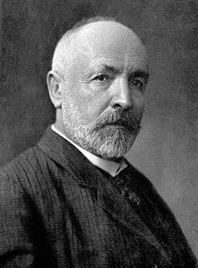
Set Theory
A set
is a well-defined
of distinct
collection objects.
The objects that make up a set (also known as the set's elements or members)
numbers, people, letters of the alphabet, other sets, and so on
Georg Cantor, one of the
founders of set theory,
Georg Cantor
A set is a gathering together into a whole of definite, distinct objects of our perception or of our thought—which are called elements of the set.
gave the following
definition of a set at the beginning

Slide 17
What is a set?
A set is a collection of well defined “objects”
People in a class: { Alice, Bob, Chris }
Classes offered by a department: { ICT 101, ICT 202, … }
Colors of a rainbow: { red, orange, yellow, green, blue, purple }
States in the US: { Alabama, Alaska, Virginia, … }
All positive numbers less than or equal to 5: {1, 2, 3, 4, 5}

Slide 18
Set properties 1
Order does not matter
– We often write them in order because it is easier for humans to understand it that way
– {1, 2, 3, 4, 5} is equivalent to {3, 5, 2, 4, 1}
Sets are notated with curly brackets

Slide 19
Set properties 2
Sets do not have duplicate elements
Consider the set of vowels in the alphabet.
It makes no sense to list them as {a, a, a, e, i, o, o, o, o, o, u}
What we really want is just {a, e, i, o, u}
Consider the list of students in this class
Again, it does not make sense to list somebody
twice
Note that a list is like a set, but order does matter and duplicate elements are allowed
We won’t be studying lists much in this class
22

Slide 20
Specifying a set 1
Sets are usually represented by a capital letter (A, B, S, etc.)
Elements are usually represented by an italic lower-case letter (a, x, y, etc.)
Easiest way to specify a set is to list all the elements: A = {1, 2, 3, 4, 5}
– Not always feasible for large or infinite sets

Slide 21
Specifying a set 2
Can use set-builder notation
D = {x | x is prime and x > 2}
E = {x | x is odd and x > 2}
The vertical bar means “such that”
Thus, set D is read (in English) as: “all elements x
such that x is prime and x is greater than 2”

Slide 22
Specifying a set 3
A set is said to “contain” the various “members” or “elements” that make up the set
If an element a is a member of (or an element of) a set S, we use then notation a ∈ S
4 ∈ {1, 2, 3, 4}
If an element is not a member of (or an element of) a set S, we use the notation a ∉ S
7 ∉ {1, 2, 3, 4}
Virginia ∉ {1, 2, 3, 4}

Slide 23
Often used sets
N = {0, 1, 2, 3, …} is the set of natural numbers
Z = {…, -2, -1, 0, 1, 2, …} is the set of integers
Z⁺ = {1, 2, 3, …} is the set of positive integers (a.k.a whole numbers)
Note that people disagree on the exact definitions of whole numbers and natural numbers
Q = {p/q | p ∈ Z, q ∈ Z, q ≠ 0} is the set of rational numbers
Any number that can be expressed as a fraction of two integers (where the bottom one is not zero)
R is the set of real numbers

Slide 24
The universal set 1
U is the universal set – the set of all of elements (or the “universe”) from which given any set is drawn
For the set {-2, 0.4, 2}, U would be the real numbers
For the set {0, 1, 2}, U could be the natural numbers (zero and up), the integers, the rational numbers, or the real numbers, depending on the context

Slide 25
The universal set 2
For the set of the students in this class, U would be all the students in the University (or perhaps all the people in the world)
For the set of the vowels of the alphabet, U
would be all the letters of the alphabet
To differentiate U from U (which is a set operation), the universal set is written in a different font (and in bold and italics)

Slide 26
Venn diagrams
Represents sets graphically
The box represents the universal set
Circles represent the set(s)
Consider set S, which is the set of all vowels in the alphabet
The individual elements are usually not written in a Venn diagram
b | c | d
g | h | j
k | l | m
n | p | q
r | s | t
v | w | x
y | z
f
U
S
a
e
i
o u

Slide 27
Sets of sets
Sets can contain other sets
– S = { {1}, {2}, {3} }
– T = { {1}, {{2}}, {{{3}}} }
– V = { {{1}, {{2}}}, {{{3}}}, { {1}, {{2}}, {{{3}}} } }
V has only 3 elements!
Note that 1 ≠ {1} ≠ {{1}} ≠ {{{1}}}
– They are all different

Slide 28
The empty set 1
If a set has zero elements, it is called the empty (or null) set
Written using the symbol ∅
Thus, ∅ = { } ← VERY IMPORTANT
If you get confused about the empty set in a problem, try replacing ∅ by { }
As the empty set is a set, it can be a element of other sets
{ ∅, 1, 2, 3, x } is a valid set

Slide 29
The empty set 1
Note that ∅ ≠ { ∅ }
The first is a set of zero elements
The second is a set of 1 element (that one element being the empty set)
Replace ∅ by { }, and you get: { } ≠ { { } }
It’s easier to see that they are not equal that way

Slide 30
Set equality
Two sets are equal if they have the same elements
– {1, 2, 3, 4, 5} = {5, 4, 3, 2, 1}
Remember that order does not matter!
– {1, 2, 3, 2, 4, 3, 2, 1} = {4, 3, 2, 1}
Remember that duplicate elements do not matter!
Two sets are not equal if they do not have the same elements
– {1, 2, 3, 4, 5} ≠ {1, 2, 3, 4}

Slide 31
Subsets 1
If all the elements of a set S are also elements of a set T, then S is a subset of T
– For example, if S = {2, 4, 6} and T = {1, 2, 3, 4, 5, 6, 7}, then S is a subset of T
This is specified by S ⊆ T
Or by {2, 4, 6} ⊆ {1, 2, 3, 4, 5, 6, 7}
If S is not a subset of T, it is written as such: S ⊆ T
– For example, {1, 2, 8} ⊆ {1, 2, 3, 4, 5, 6, 7}

Slide 32
Subsets 2
Note that any set is a subset of itself!
Given set S = {2, 4, 6}, since all the elements of S are elements of S, S is a subset of itself
This is kind of like saying 5 is less than or equal to 5
Thus, for any set S, S ⊆ S

